Slide 1

Syrian Private University
Department of Software Engineering and
Intelligent Systems
SMART HEALTH ASSISTANT
Prepared by:
May Al-Zoubi Malek Essa
Supervised by :
Eng. Shadi Blaidi Eng. Maya Al-Ahmad
Academic Year: 2025-2026

Slide 2
1- Abstract/Introduction
In light of rapid technological development, smartphones and mobile devices have become an integral part of our daily lives . This project focuses on building a smart health assistant designed to track and improve essential daily habits, with an emphasis on sleep quality and current water consumption, due to their direct impact on mental and physical activity, the healthiness of the food consumed, and the creation of a medical record and a first aid section in the future. The project targets all individuals, especially students, to enhance academic productivity.

Slide 3
2-Problem Statement & Objectives
Problem Statement :
Many individuals, especially in academic and work environments filled with pressure, suffer from difficulty maintaining a balanced healthy routine. The core problem lies in neglecting vital habits such as drinking sufficient amounts of water and getting regular sleep hours, which leads to exhaustion, poor concentration, and decreased productivity.
:Project Objectives
The primary goal of this project is to design and develop a "Smart Health Assistant" application that enhances health awareness and fosters positive habit formation among users.

Slide 4
1-2-Objective:
Main Objective:
Tracking Vital Habits: Providing a user-friendly interface to record and monitor daily sleep duration and water consumption.
Smart Analysis and Alerting: Processing user data to deliver customized notifications and reminders at appropriate times, helping users adhere to their healthy routines.
Sustainable Motivation: Designing a User Experience (UX) that encourages long-term consistency and reduces the likelihood of abandoning the app.
Periodic Reporting: Displaying weekly or monthly summaries that illustrate the user's progress and the impact of their commitment on overall well-being.

Slide 5
3-Project Scope, Constraints, and Assumptions
Scope: The project covers the development of a mobile application with a dedicated backend to manage user profiles, track water and sleep data, and provide intelligent notification logic.
Constraints: The development is limited to the academic semester timeline (ending in April 2026). It also relies on the availability of standard smartphone sensors and consistent internet for cloud syncing.
Assumptions: It is assumed that users possess basic smartphone literacy and that improving tracking habits will lead to better health outcomes for the target audience.

Slide 6
4-Related Work & Research Gap
The solution is in our project | Weaknesses | Strengths | The main focus | For the similar application/system
Data linking: Integrating sleep data with water drinking rate to provide comprehensive recommendations that explain the causes of fatigue | It operates independently of the rest of the habits; it does not link sleep quality to water consumption or daily exertion | Detailed sleep quality reports, and a smart alarm that actively wakes the user | Analysis of sleep patterns and stages in detail | Sleep Tracking Applications (Sleep Cycle)
Smart notifications: Using algorithms that adapt to the user's schedule to send alerts at the appropriate time only. | "Blind" notifications may disturb the student during lectures or nap times | A very simple interface, and speed in data entry | Track the amount of fluids consumed and send notifications to | Water reminder applications (WaterMinder)
Simplified interface: A design that focuses only on basic habits to reduce distraction and lower the learning curve for a smooth experience | Complex interfaces crowded with details distract the simple user. | High motivation for users to ensure continuity through the 'Gamification' approach | A huge set of daily habits and diets | Comprehensive systems (Habitica)

Slide 7
5-Development Methodology & Project Plan
Waterfall Methodology: This traditional approach was chosen due to the clear, well-defined requirements established at the beginning of the academic semester. The project progressed linearly through specific phases: Requirements Analysis, System Design, Implementation, Testing, and Deployment, ensuring each phase was fully documented and verified before moving to the next.
Tools:
Flutter: For creating a responsive and unified user interface across mobile platforms.
Python: For backend logic, processing hydration algorithms, and managing notification scheduling.
MySQL & SQLite: Used for cloud synchronization and local data persistence respectively, ensuring offline functionality.

Slide 8
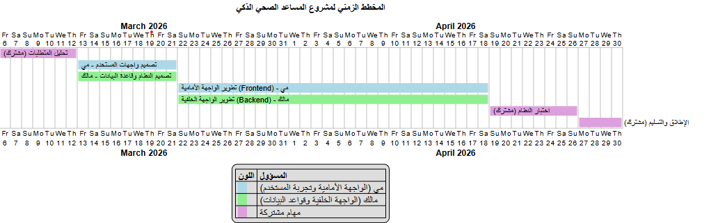
6-Project Timeline (Gantt Chart)

Slide 9
7-Functional Requirements (FR):
Add a shortcut on the screen | Login and create
Export reports | Recording sleep hours
Recording the amount of water consumed | Bedtime alarm
Smart water notifications | Manually editing the goals
Achievements system | Beverage customization
Providing tips | Profile management
Fasting mode | Daily progress monitoring
 | Edit previous entries

Slide 10
8-Non-Functional Requirements (NFR):
Requirement | Category
Data synchronization and screen transitions must occur with a response time of < 2 seconds. | Performance
User passwords must be hashed, and personal health data must be securely transmitted using HTTPS | Security
The UI must allow users to log their water intake in no more than 3 screen taps. | Usability
The app must remain functional offline using SQLite, syncing automatically when reconnected. | Reliability

Slide 11
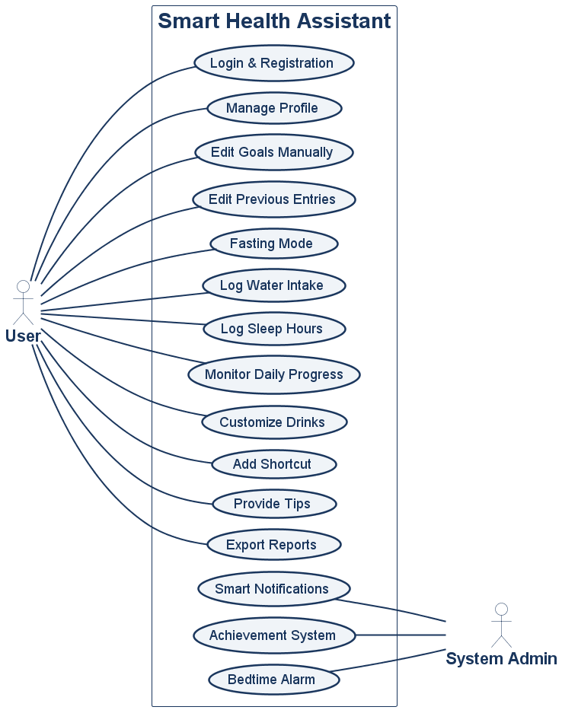
(Use case):9-UML Diagrams

Slide 12
10-Use Case : Log Water Intake
Use Case Name | Log Water Intake
ID | UC-08
Actors | User
Description | This use case allows the user to input the amount of water or liquids consumed, so the system can document it and calculate it within the user's specific daily goal.
Preconditions | User successfully logged into the application (UC-01).
Main Flow | 1. The user clicks the "Add Water" button on the main app interface. 2. The system displays options for default sizes (250ml cup, 500ml bottle). 3. The user selects the desired amount and confirms the entry. 4. The system receives the data and adds it to the daily total consumption. 5. The system saves the record in the database. 6. The system updates the progress indicator (Water Progress Ring) on the main screen.
Alternative Flows | Extended Flow (Beverage Customization): Before confirming in step 3, the user selects the beverage type (e.g., coffee, tea). The system intervenes programmatically to calculate the actual hydration ratio (coffee is calculated at a lower percentage than pure water) and adds it to the goal. Extended Flow (Shortcut): The user skips steps 1 and 2 by logging the water amount directly via a smartphone Widget, and the system executes steps 4 to 6 in the background. Offline mode: Data is saved in SQLite to sync later.
Postconditions | The total consumed fluids for the current day is increased, and the completion percentage in the progress monitoring interface is updated

Slide 13
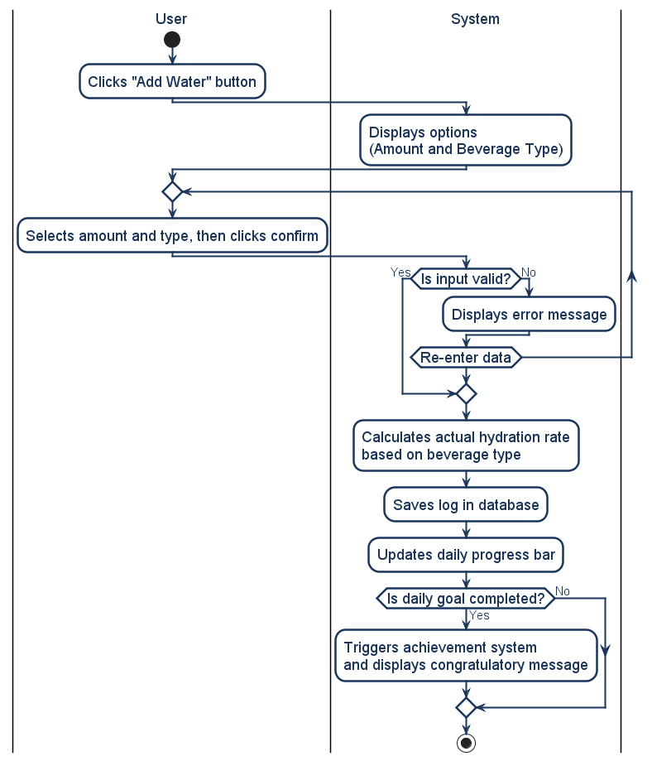
11-(Activity Diagram for Water intake log)

Slide 14
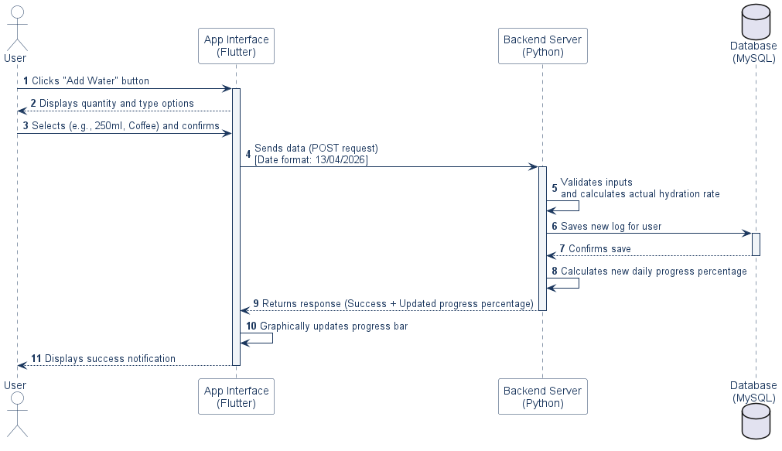
12-Sequence Diagram

Slide 15
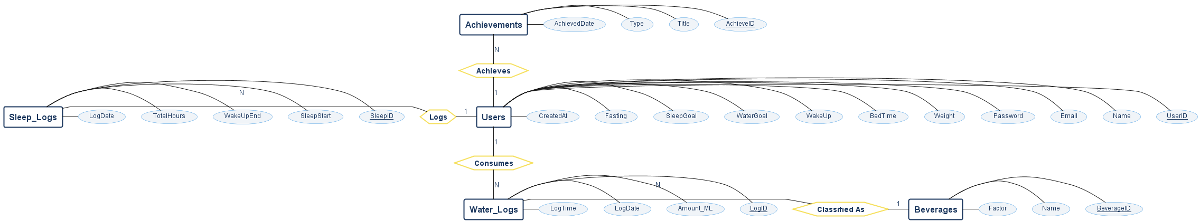
13-Database / Data Model
ERD:

Slide 16
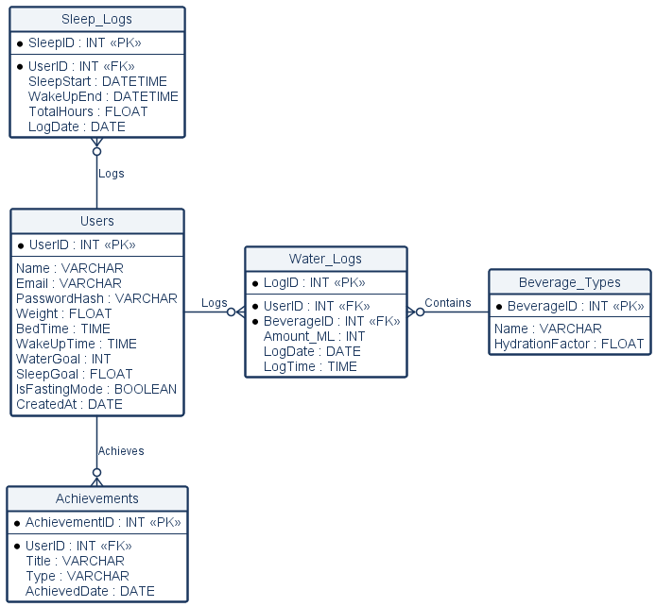
:14-Database schemes

Slide 17
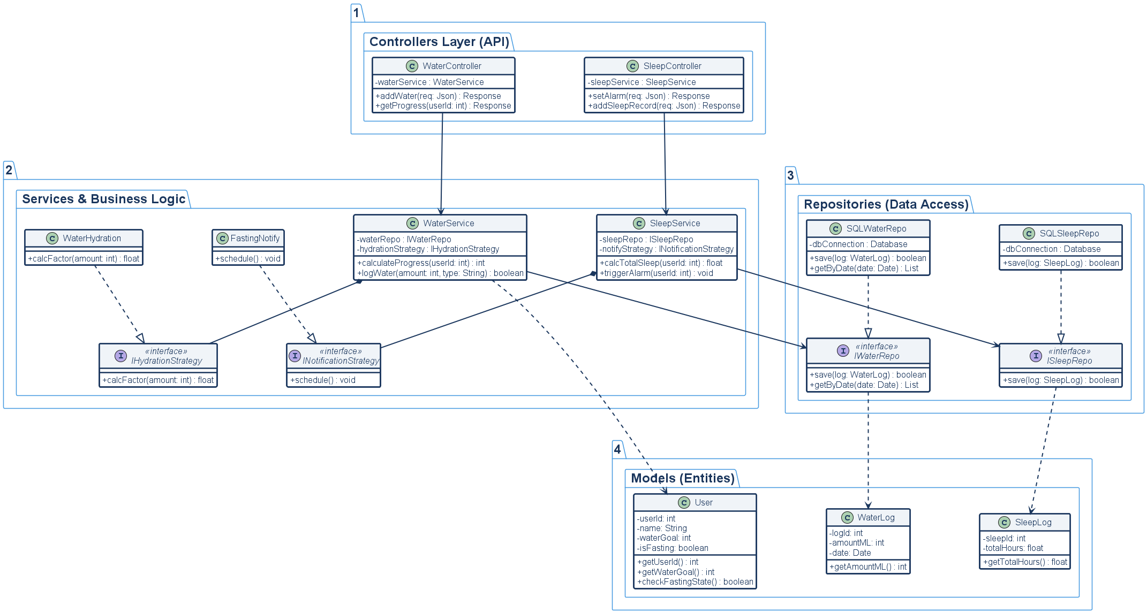
:15-Class Diagram

Slide 18
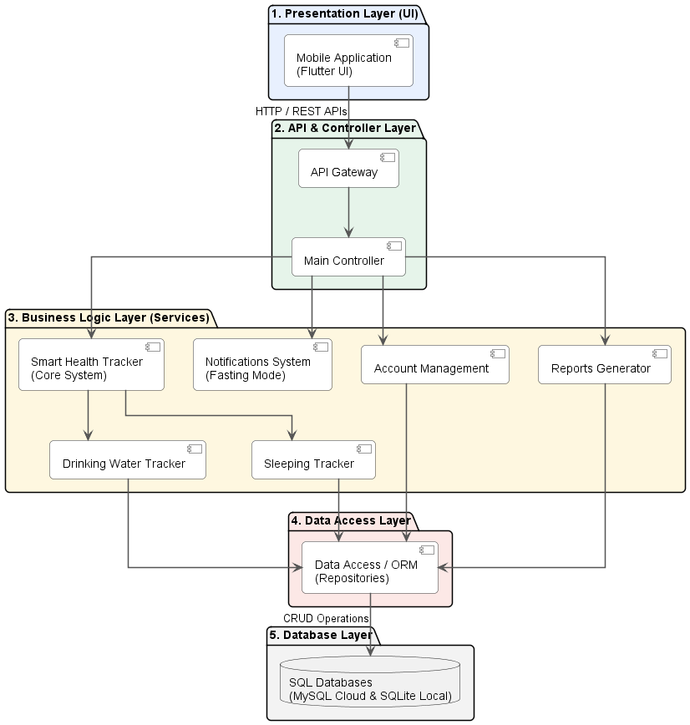
((Layered:16-System Architecture

Slide 19
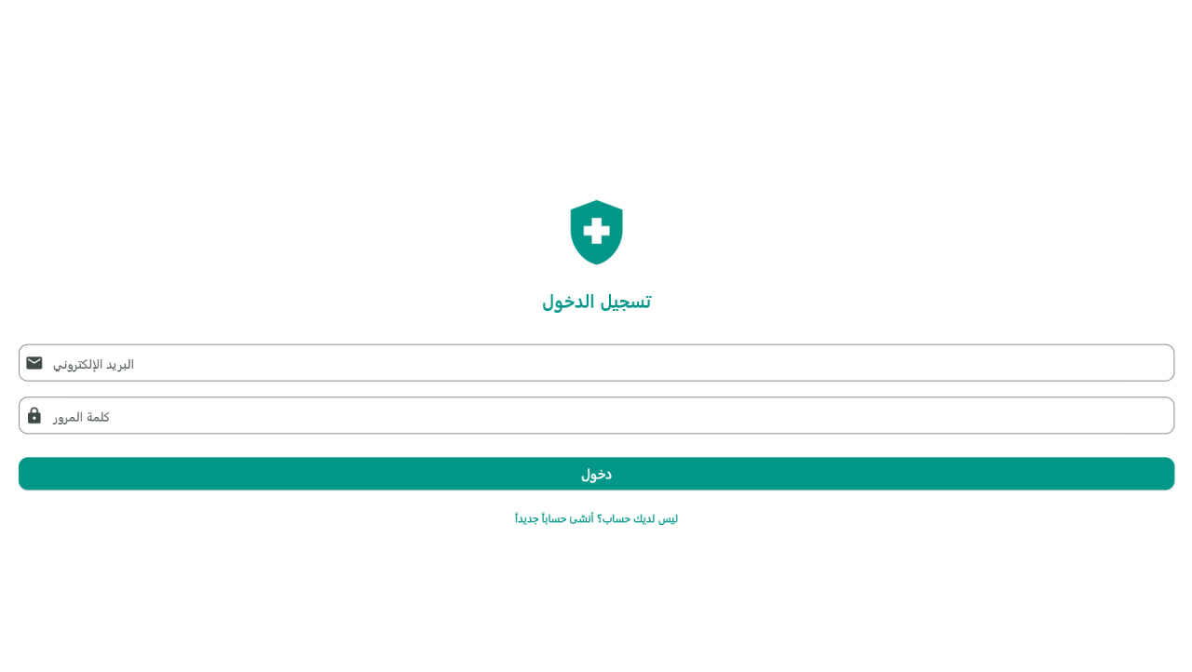
( login screen)1-17-:17-User Interface

Slide 20
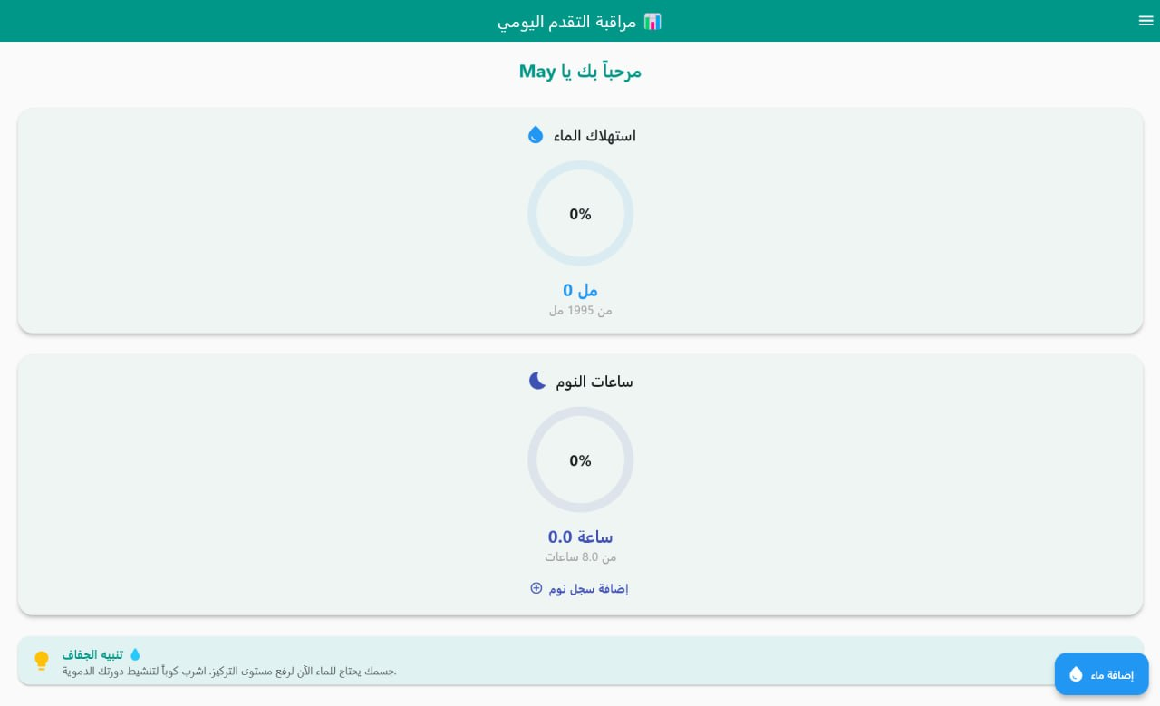
:2-17-Upload / Input screen

Slide 21
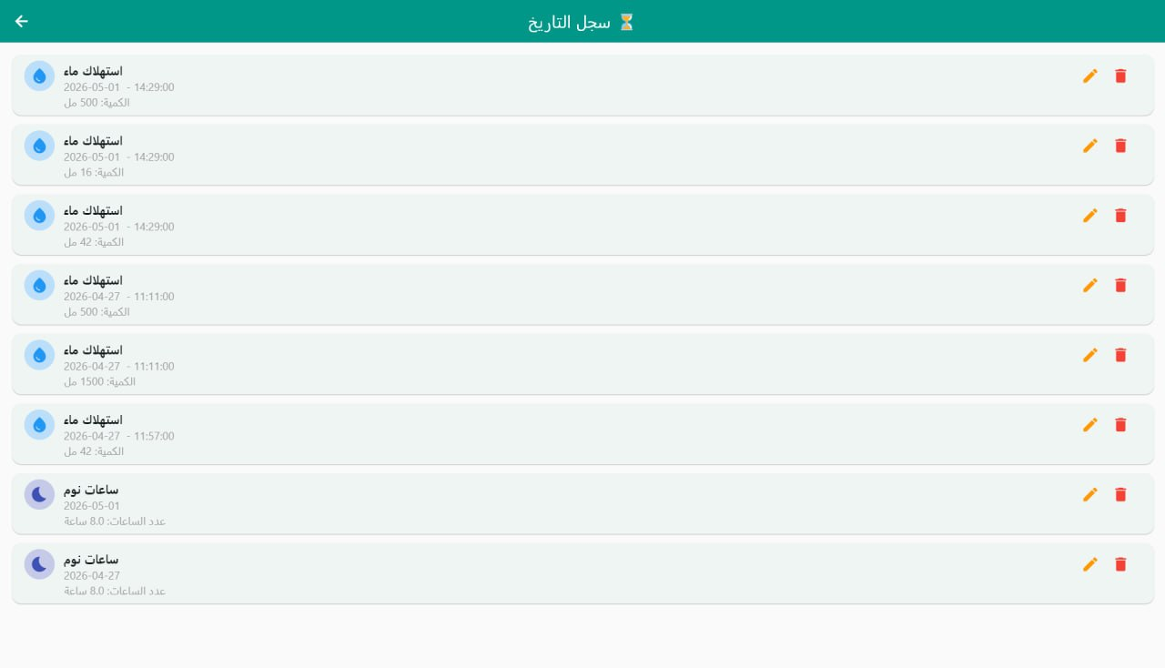
:3-17-Classification result with recommendation

Slide 22
18-Testing:
Test Case ID | Description / Scenario | Linked Requirement | Expected Result
TC-01 | User submits valid registration details. | ID-01 (Auth) | Account is created, and the user is redirected to the main dashboard.
TC-02 | User updates daily water and sleep goals. | ID-02 (Profile) | System recalculates daily targets and updates the progress rings immediately.
TC-03 | User logs 250ml of a caffeinated beverage. | ID-03 (Hydration) | System applies the specific hydration multiplier and adds the net value to the daily progress.

Slide 23
:19-Requirements Traceability Matrix (RTM)
Req ID | Requirement Description | Use Case | Design | Design Description | Implementation | Test Case ID
ID-01 | User authentication and account creation | Login & Sign up Use Case | Auth UI Design | User enters email and password to log in | Auth Module Developed | TC-01
ID-02 | Update personal health data and goals | Profile Management Use Case | Profile Settings Design | User inputs weight and sleep targets | Profile Module Developed | TC-02
ID-03 | Log consumed beverages with hydration factors | Log Water Intake Use Case | Dashboard UI Design | Calculate net hydration based on drink type | Hydration Service Developed | TC-03
ID-04 | Modify or delete past entries | Edit Previous Entries Use Case | History Log Design | User can edit or remove past data logs | Data Management Module Developed | TC-04
ID-05 | Pause daytime notifications during fasting | Fasting Mode Use Case | Notification Control Design | Silence alerts based on specific timeframes | Notification Scheduler Developed | TC-05

Slide 24
:20-Conclusion & Future Work
Project Accomplishments Summary :We successfully designed and built a highly efficient, production ready, multi-platform health ecosystem. The solution provides users with deep physiological insights while maintaining structural simplicity.
Future Work : Diet and Nutrition Module: Expanding the tracking capabilities beyond water and sleep to include daily caloric intake and macro nutrient distribution.

